Slide 1
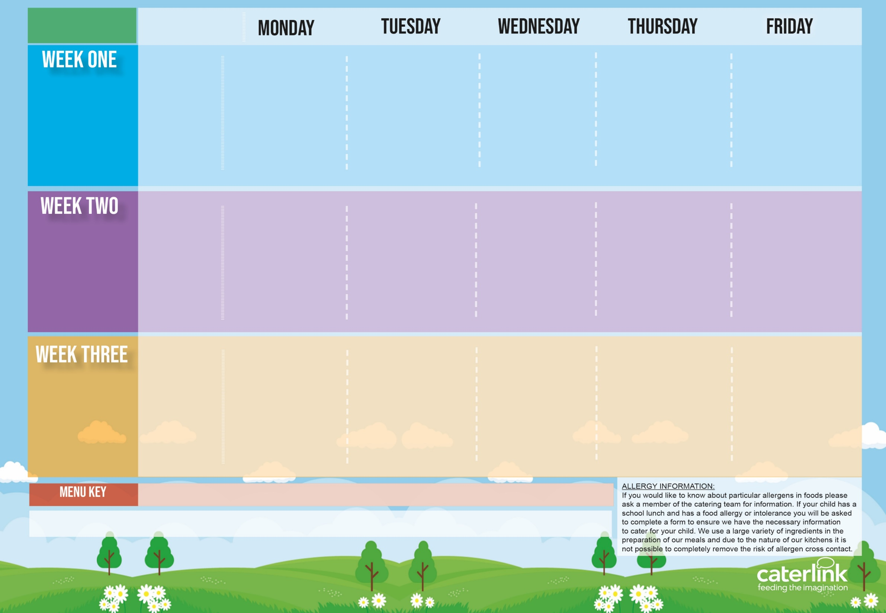





Autumn Winter
2025 2026
Option One
Option Two
Vegetables
Dessert
Tomato Pasta and Garlic Bread | Cheese and Bean Pasty with Potato Wedges | Roast of the Day, Roast Potatoes and Gravy | Chicken Curry with Rice | Fishfingers with Chips & Tomato Sauce
Jacket Potato with Cheese or Beans | Cheese or Ham wrap with Potato Wedges | Jacket Potato with Cheese or Beans | Cheese or Tuna Wrap with Tater Tots | Jacket Potato with Cheese or Beans
Vegetables of the Day | Vegetables of the Day | Vegetables of the Day | Vegetables of the Day | Vegetables of the Day
Dessert of the Day | Dessert of the Day | Dessert of the Day | Dessert of the Day | Dessert of the Day
Option One
Option Two
Vegetables
Dessert
Macaroni Cheese And Garlic Bread | Hot Dog and Tater Tots | Sausage and Mash Vegetarian Sausage and Mash | Spaghetti Bolognaise | Fishfingers and Chips with Tomato Sauce
Jacket Potato with Beans or Cheese | Vegi Dog with Tater Tots |  | Cheese or Ham Wrap with Potato Wedges | Margarita Pizza
Vegetables of the Day | Vegetables of the Day | Vegetables of the Day | Vegetables of the Day | Vegetables of the Day
Dessert of the Day | Dessert of the Day | Dessert of the Day | Dessert of the Day | Dessert of the Day
Option One
Option Two
Vegetables
Dessert
Sausage Roll and Diced Potatoes | Pizza and Wedges | Spaghetti and Meatballs | Beefburger and Wedges Cheese Wrap with Potato Wedges Vegetables of the Day Dessert of the Day | Fishfingers with Chips & Tomato Sauce
Jacket Potato with Beans or Cheese Vegetables of the Day Dessert of the Day | Cheese or a Tuna Wrap with Wedges Vegetables of the Day Dessert of the Day | Jacket Potato with Beans or Cheese Vegetables of the Day Dessert of the Day |  | Jacket Potato with Cheese or Beans Vegetables of the Day Dessert of the Day
Added Plant Protein
Wholemeal
Vegan
Chef’s Special
Available Daily: - Freshly cooked jacket potatoes with a choice of fillings - Bread freshly baked on site daily- Daily salad selection – Fresh Fruit and Yoghurt

